Slide 1

Summer 2026
Longhorn hapkit
Lab guide #2 - morning
Ross neuman
Assistant Professor of Practice, The University of Texas at Austin

Slide 2
https://github.com/rneum/RobotCamp2026

Slide 3
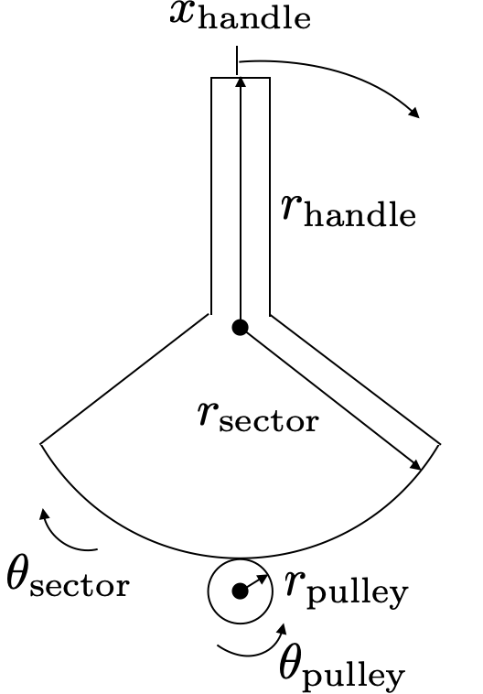
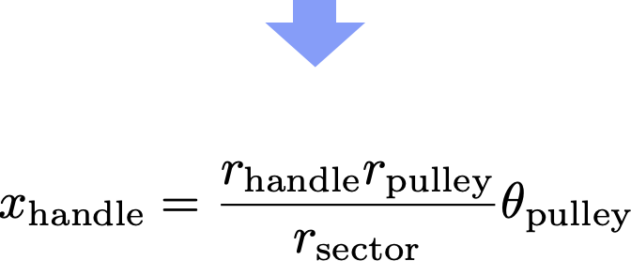
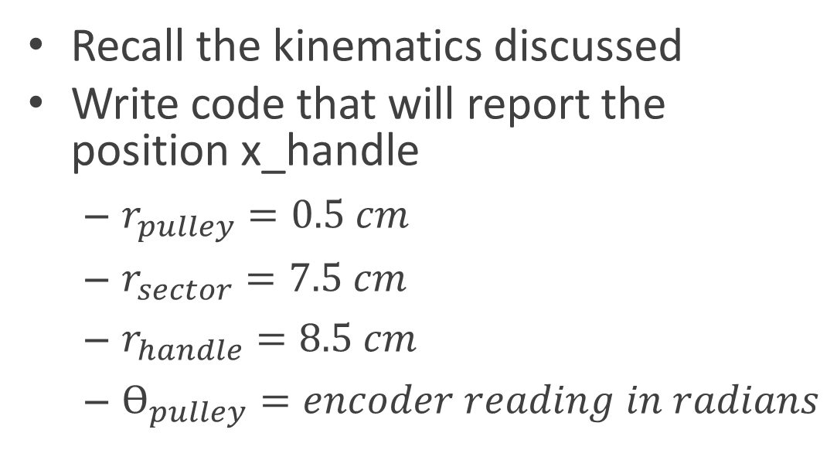
Kinematics for handle
Recall the kinematics discussed
Write code that will report the position x_handle
$r_{pulley}=0.5 cm$
$r_{sector}=7.5 cm$
$r_{handle}=8.5 cm$
$ϴ_{pulley}=encoder reading in radians$

Slide 4
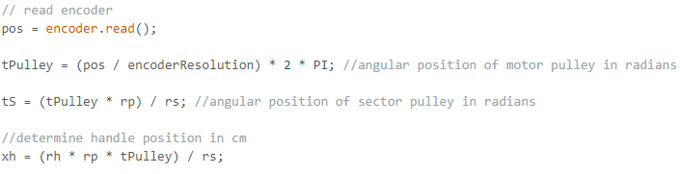
Kinematics for handle
Code should look something like this
xh is the position of the handle in cm

Slide 5
Now we will use this position to inform:
A virtual spring
A virtual wall

Slide 6
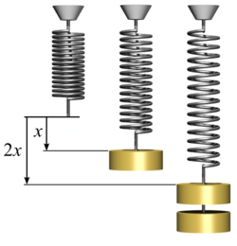

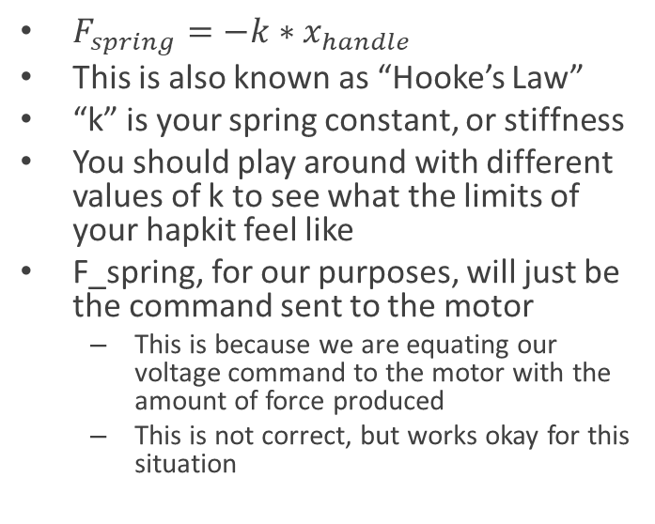
Virtual Spring
$F_{spring}=−k∗x_{handle}$
This is also known as “Hooke’s Law”
“k” is your spring constant, or stiffness
You should play around with different values of k to see what the limits of your hapkit feel like
F_spring, for our purposes, will just be the command sent to the motor
This is because we are equating our voltage command to the motor with the amount of force produced
This is not correct, but works okay for this situation

Slide 7
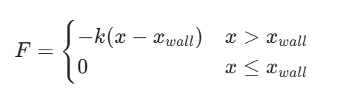
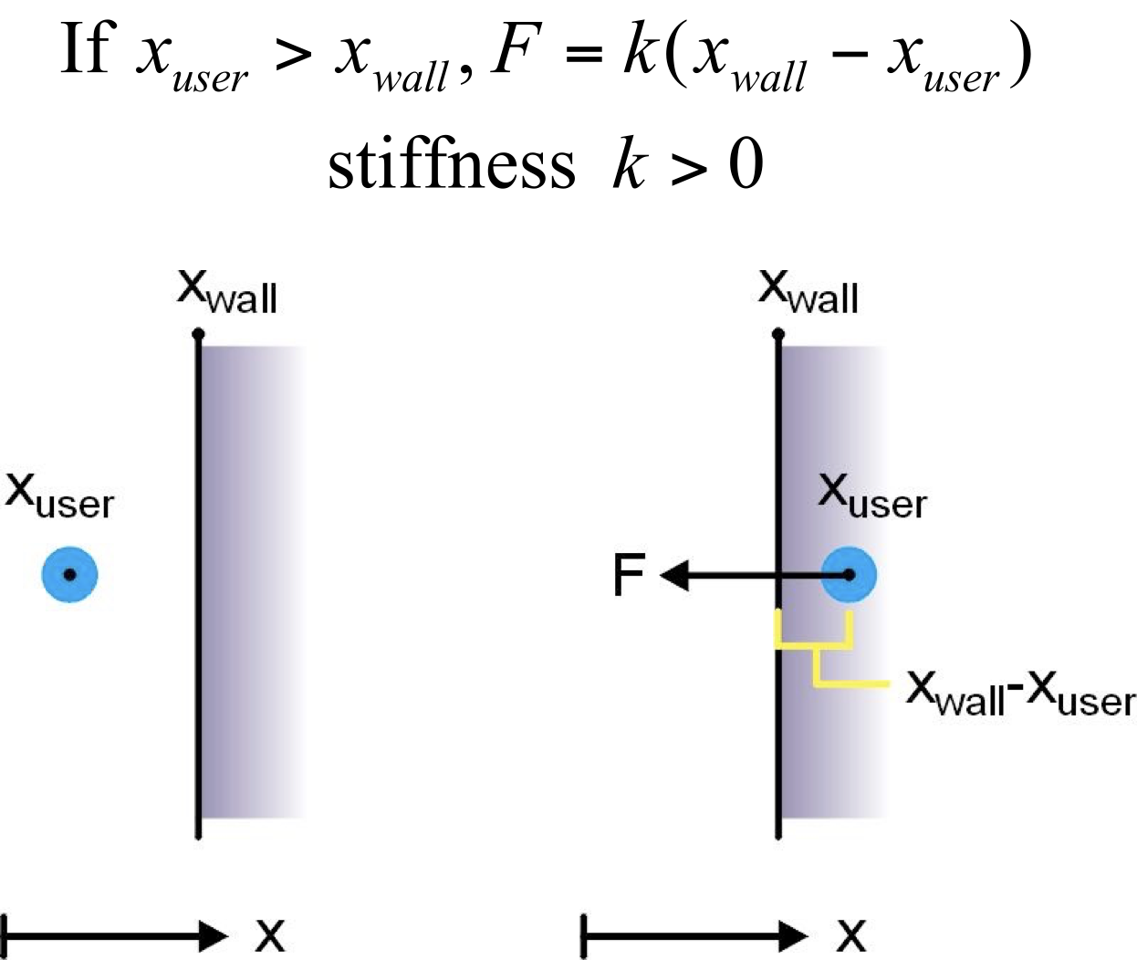
Create a Virtual Wall
Decide on a location for your wall
Write a conditional statement (if/else) that will command a very high stiffness once you are “inside” the wall

Slide 8
With your virtual wall
Try moving the wall around
Place at +3cm
Place at -2cm
Place two virtual walls simulateously

Slide 9
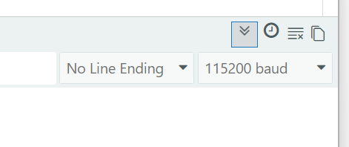

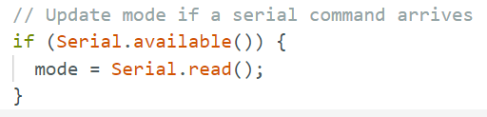
Use serial to send commands
Serial can also be used to send commands, not just read out what the program is offering
Serial.read() tells the serial monitor to read commands the user is entering when available
Set serial monitor to “no line ending”
Create a new variable called “mode” that you will use to tell the program which haptic environment to render
Put this at the top where you are declaring other variables like pos, xh, etc.
Now in loop() you can read for the mode
Continued on next page…
With variable declarations:
In loop():

Slide 10
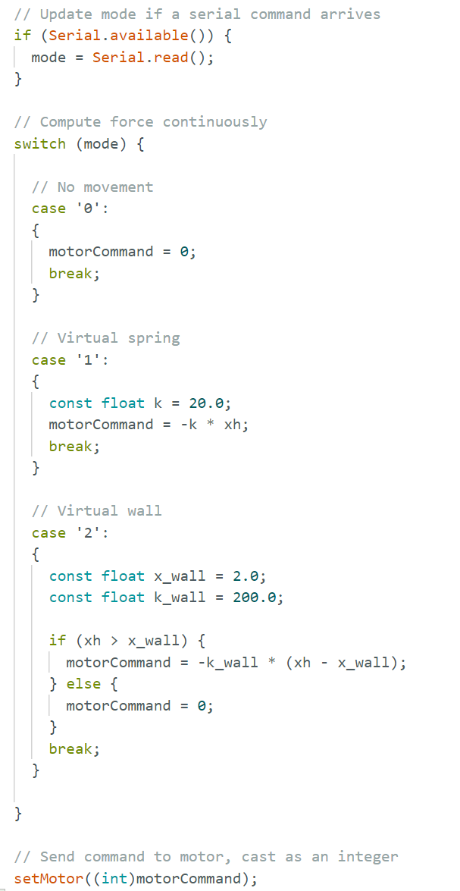
Commanding Modes
The code shown to the side implements a switch statement that allows you to switch between your spring and wall mode without re-uploading the code
You can add more cases to this statement as you develop more virtual environments if you like this workflow better

Slide 11
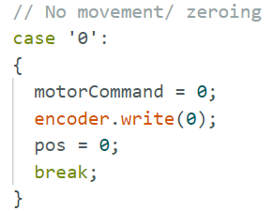
Make a zeroing function
Another convenient function is to have one that resets the encoder to 0
If your capstan slips at all, use this to re-establish your x = 0 point
Simply use encoder.write() to tell it the position is now 0
I like to make this my “0” function in the switch statement

Slide 12
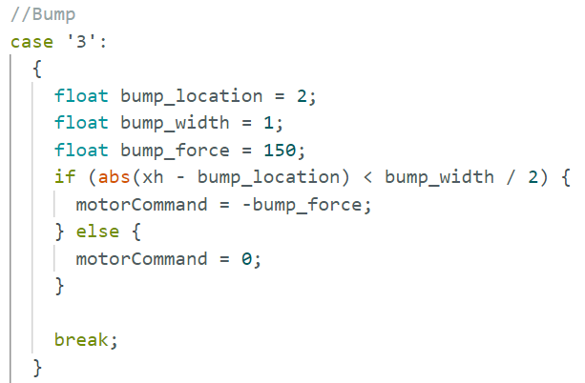
Make a simple “bump”
Place a “bump” at a desired location
Play around with the parameters (width, force, location)
Try creating multiple bumps
See if you can design a way to make this bump feel more realistic

Slide 13
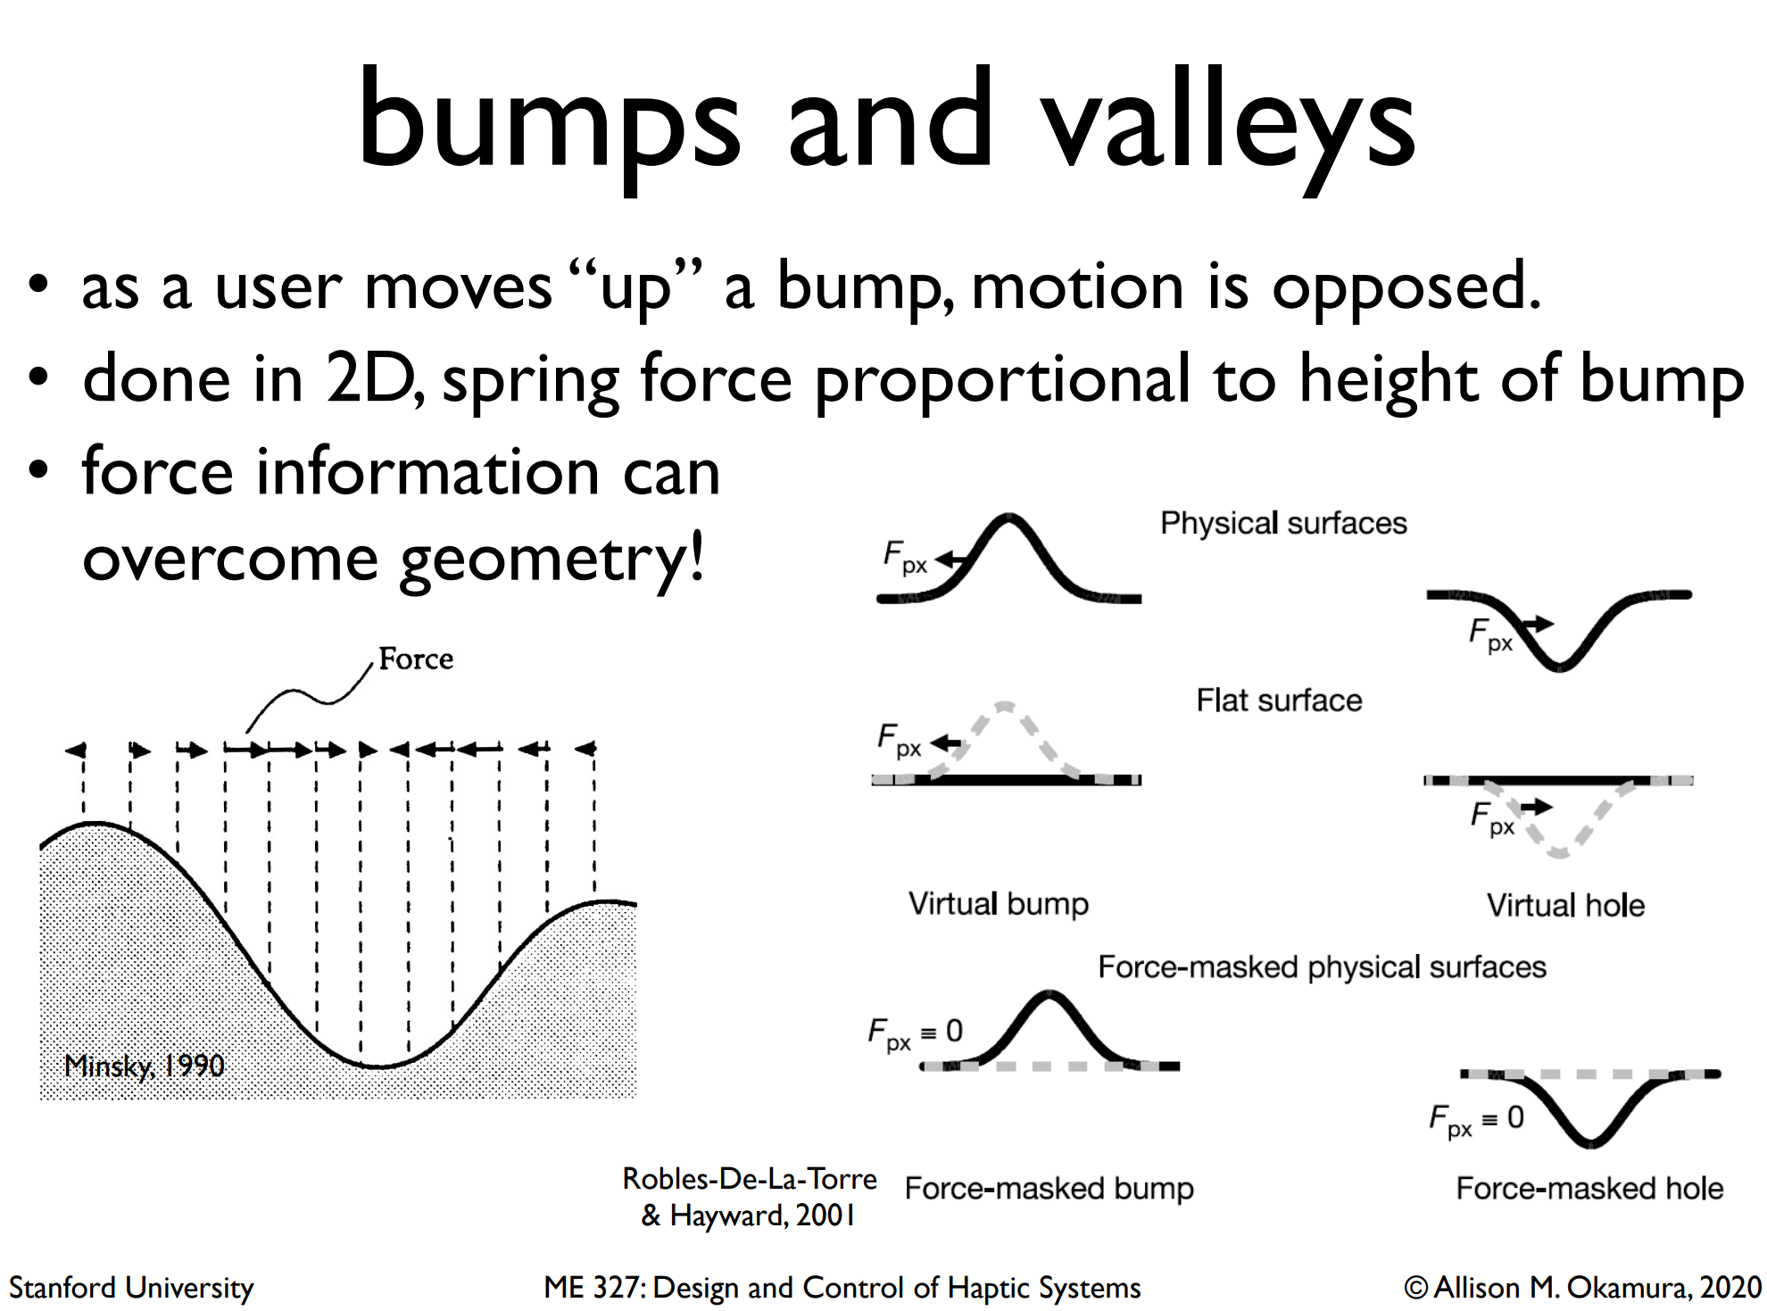
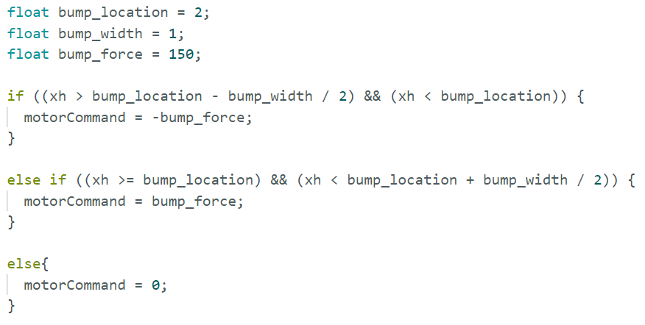
More realistic bump
A real bump will push against you on the way “up” and then help you along on the way “down”
Turn this bump into a valley instead

Slide 14
Bump and Valley – Continued Improvement
For an extra challenge--can you make it feel like a smooth hill instead?
Could use sinusoids
Could use piecewise functions

Slide 15
Continue to experiment with Composing virtual environments
Get creative, see what you can make!

